Slide 1

Course : ENTR6003 – Entrepreneurship 1
Year : September 2017
“Prototyping” (S)
Session 8
F2F

Slide 2
LO 2: Describe the Value Propositon of the Created Business Idea LO 3: Assess the Value Proposition of the Created Business Idea
Learning Objectives

Slide 3
Sub Topics
The Importance of Prototyping
10 Principles of Prototyping
Workshop of Prototyping

Slide 4
The Importance of Prototyping

Slide 5
What is Prototype?
A prototype is
a thinking tool that helps us explore different directions in which we could take our business model.
A business model prototype can be
anything from a rough sketch of an idea
on a napkin to a detailed Business Model Canvas to a field-testable business model.

Slide 6
Benefit of Prototyping
Prototyping is a powerful tool for developing new,
Innovative business models
It makes abstract concepts
tangible and facilitates the exploration of new ideas.
It can make an important contribution
to business model design.
as tools that serve the purpose of discussion,
inquiry, or proof of concept

Slide 7
Questions on Prototyping
What does it mean for the model if we add another client segment?
What are the consequences of removing a costly resource?
What if we gave away something for free and replaced that Revenue Stream with something more innovative?

Slide 8
10 Principles of Prototyping

Slide 9










The 10 Principles
Make it visual
and tangible
Embrace
a beginner’s mind
Do not fall
to the first idea,
create alternatives
Keep it liquid,
As it is not clear yet
Start with
low fidelity,
Iterate and refine
Use creativity
techniques
Track learnings,
Insights, and progress
Expose your
work clearly
- Seek criticism
Learn faster
by falling early,
Often and early cheaply
Create the totally
Different models
that you are
unlikely to build,
To trigger debate
and learning process

Slide 10
Mapping the Value Proposition

Slide 11
Mapping the VP
Things to Remembers:
Remarkable Value Propositions focus on jobs, pains and gains that matter to customers and achieve those exceedingly well.
The whole – if possible – pains and gains of the customers should be addressed. Focusing on these would make some differences for the customers.

Slide 12
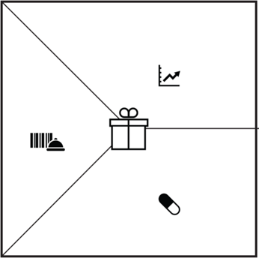
Mapping the VP
Gain creators highlight how exactly the products & services help customers achiave gain. Each gain creator addressed at least one of more pains or gains.
The list of the products and services that the value propositions builds on the specific customer segment.
Pain relievers outline how exactly the products & service kill customers pains. Each pain reliever addresses at least one or more pains or gains.

Slide 13
Mapping How the Products Create Value

Slide 14

The Objective
Giving the clear description, explicitly how the product and services create value

Slide 15





The Steps
List all products &
services of your existing value proposition.
Outline gain creators
Rank it all,
by order of importance.
Outline pain reliever.

Slide 16
Workshop of Prototyping

Slide 17
Workshop
Students (in groups) would be ask to build a tower, using the newspaper.
They would have to create:
Building plan
A tower, with the newspaper and tape
Assessed aspects:
Management personnels
Planning
Prototyping

Slide 18
References
Alexander O, Yves P, Greg B, and Alan S (2014), Value Proposition Design. John Wiley & Co, New Jersey. ISBN: 978-1-118-96805

